Slide 1
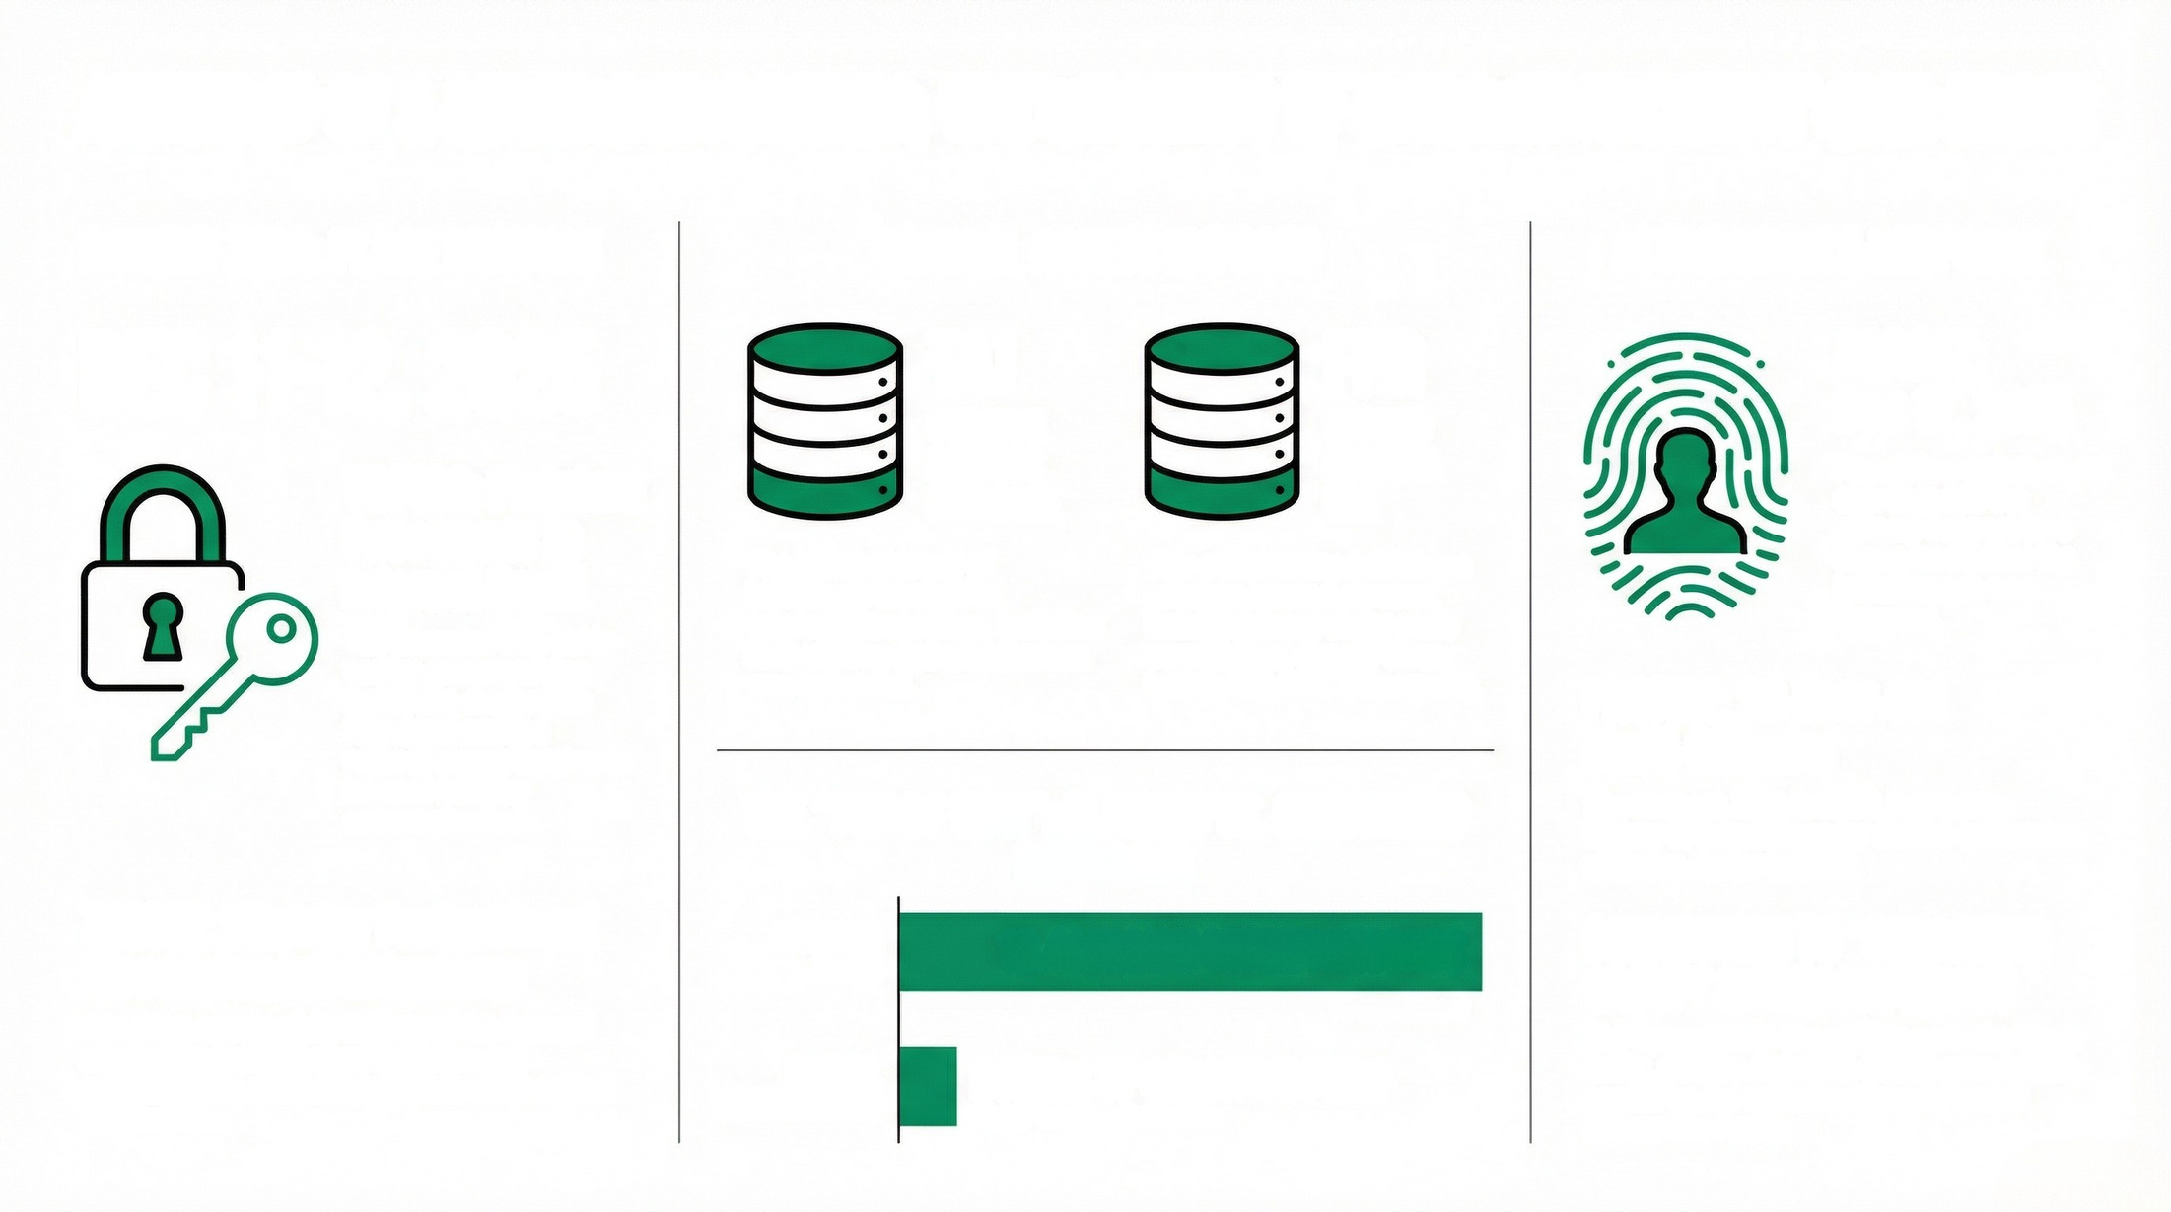
ANATOMY OF A SOVEREIGN BREACH: THE MINISTRY OF INTERIOR INCIDENT (DEC 2025)
PATIENT ZERO: PLACE BEAUVAU
CRITICAL ASSETS EXPOSED
ATTRIBUTION & RESPONSE
DEC 11-12, 2025
VECTOR: Plaintext
Passwords in
Internal Email
The intrusion was achie-
ved by compromising
legitimate credentials
found transmitted
without encryption inside
internal ministry
communications.
TAJ
FPR
ARREST:
Dec 17, 2025
French law enforcement
apprehended the
primary suspect less
than a week after the
initial breach was
detected.
CRIMINAL
RECORDS
DATABASE
WANTED
PERSONS
FILE
The judicial history of
individuals involved in
criminal proceedings, including
both victims and perpetrators,
was accessed.
This compromised database
catalogs wanted persons,
including those under state
surveillance, directly threa-
tening AML/KYC frameworks.
PROFILE: 22-Year-Old
Multi-Offender
The suspect, born in 2003, had a prior
history of convictions for similar cybercrime
offenses earlier in 2025.
THE "FOG OF WAR": CLAIMED VS. CONFIRMED
DATA LOSS
TARGET: Ministry Professional
Messaging Infrastructure
Attackers successfully infiltrated the internal
messaging systems used by police and
administrative officials to pivot to other critical
applications.
ATTACKER
CONNECTION TO “ORGANIZED
GROUP" & BREACHFORUMS
The suspect was charged as part of a larger
entity, and the data leak claims were initially
posted on the notorious Breach Forums
cybercrime forum.
16.4 MILLION CITIZEN RECORDS
CLAIM
To sow discord
OFFICIAL
CONFIRMATION
DOZENS OF SENSITIVE FILES
Highly Sensitive Exfiltration

